Slide 1
Neoliberalism, State Capacity, & Economic Growth & Development
J. Bradford DeLong
Department of Economics and Blum Center, U.C. Berkeley; and WCEG
delong@econ.berkeley.edu
last revised: 2020-02-21
for delivery: Tu 2020-02-25
<https://github.com/braddelong/public-files/blob/master/neoliberalism.pptx>

Slide 2
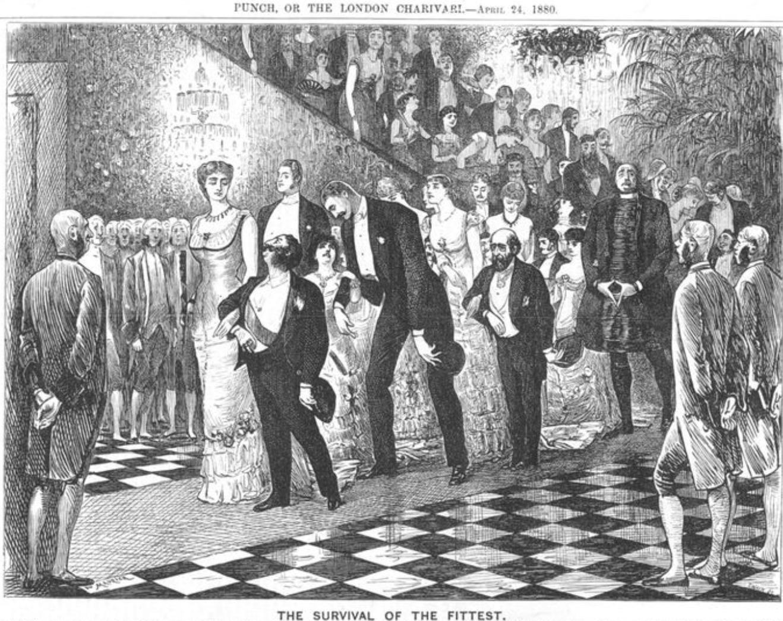
Social Darwinism & Liquidationism
“The market giveth, the market taketh away, blessed be the name of the market”
Andrew Carnegie
Herbert Hoover
Joseph Schumpeter

Slide 3
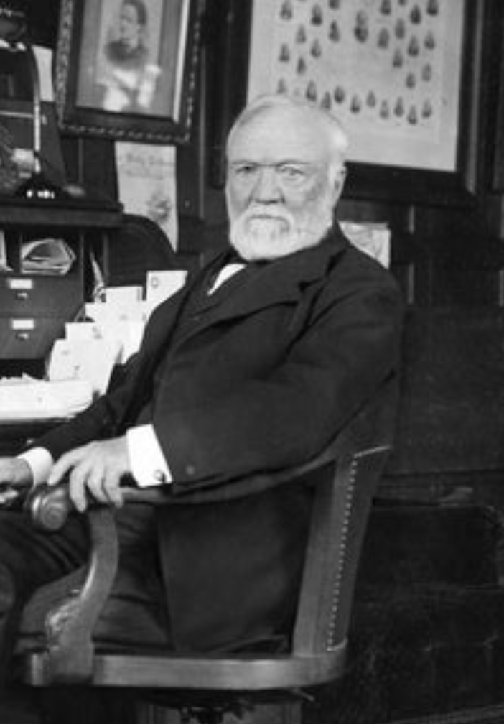
Andrew Carnegie
A man who gave away his fortune—best known for “he who dies rich, dies disgraced”:
“The price we pay for [our civilization]... is, no doubt, great.... The employer of thousands is forced into the strictest economies... [in] the rates paid to labor....
“The law of competition... is here; we cannot evade it;
“no substitutes for it have been found; and
“while the law may be sometimes hard for the individual,
“it is best for the race,
“because it insures the survival of the fittest in every department…”

Slide 4
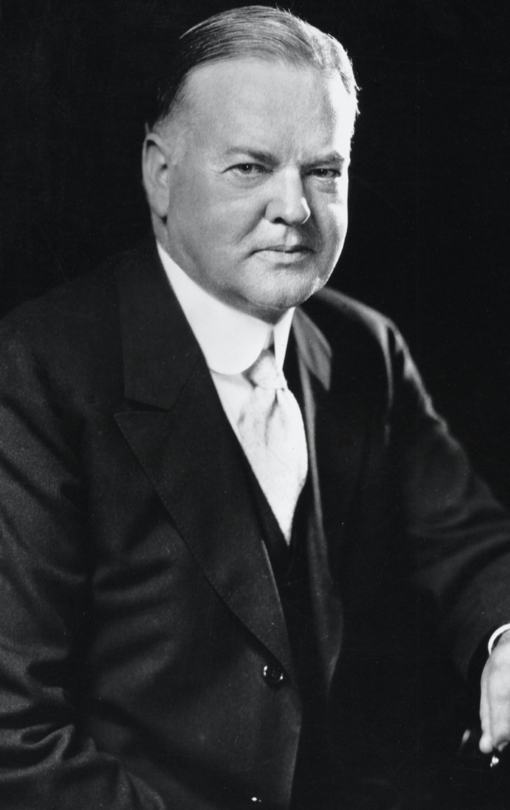
Herbert Hoover
Looking back on his own presidency:
“The ‘leave-it-alone liquidationists’, headed by Secretary of the Treasury Mellon, felt that government must keep its hands off and let the slump liquidate itself.
“Mr. Mellon had only one formula: ‘Liquidate labor, liquidate stocks, liquidate the farmers, liquidate real estate’. He held that even panic was not altogether a bad thing.
“He said:
‘It will purge the rottenness out of the system. High costs of living and high living will come down. People will work harder, live a more moral life. Values will be adjusted, and enterprising people will pick up the wrecks from less competent people…’”

Slide 5
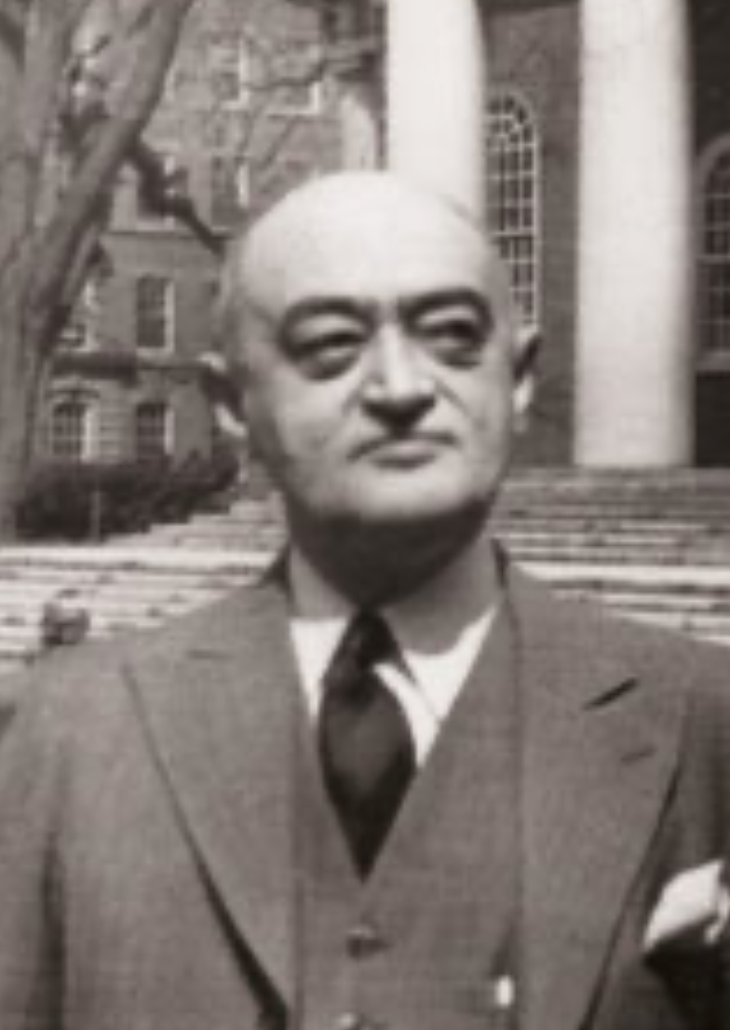
Joseph Schumpeter
Whatever is, & is in the market system, is rational:
“The problems presented by periods of depression may be grouped as follows:
“First, removal of extra economic injuries to the economic mechanism: Mostly impossible on political grounds.
“Second, relief… imperative on moral and social grounds… although no cure for fundamental cases.
“Third, remedies: The chief difficulty of which lies in the fact that depressions are not simply evils, which we might attempt to suppress, but—perhaps undesirable—forms of something which has to be done, namely, adjustment to previous economic change.

Slide 6
Joseph Schumpeter II
Whatever is, & is in the market system, is rational:
“Most of what would be effective in remedying a depression would be equally effective in preventing this adjustment. This is especially true of inflation, which would, if pushed far enough, undoubtedly turn depression in to the sham prosperity so familiar from European postwar [i.e., World War I] experience, but which, if it be carried to that point, would, in the end, lead to a collapse worse than the one it was called in to remedy….
“Fourth, reforms of institutions intended to remedy the situation but suggested by the moral and economic evils of both booms and depressions…. A political atmosphere exceptionally favorable, and an economic situation exceptionally unfavorable to their success… will… be stigmatized in the future by their tendency to prevent or retard recovery…”

Slide 7
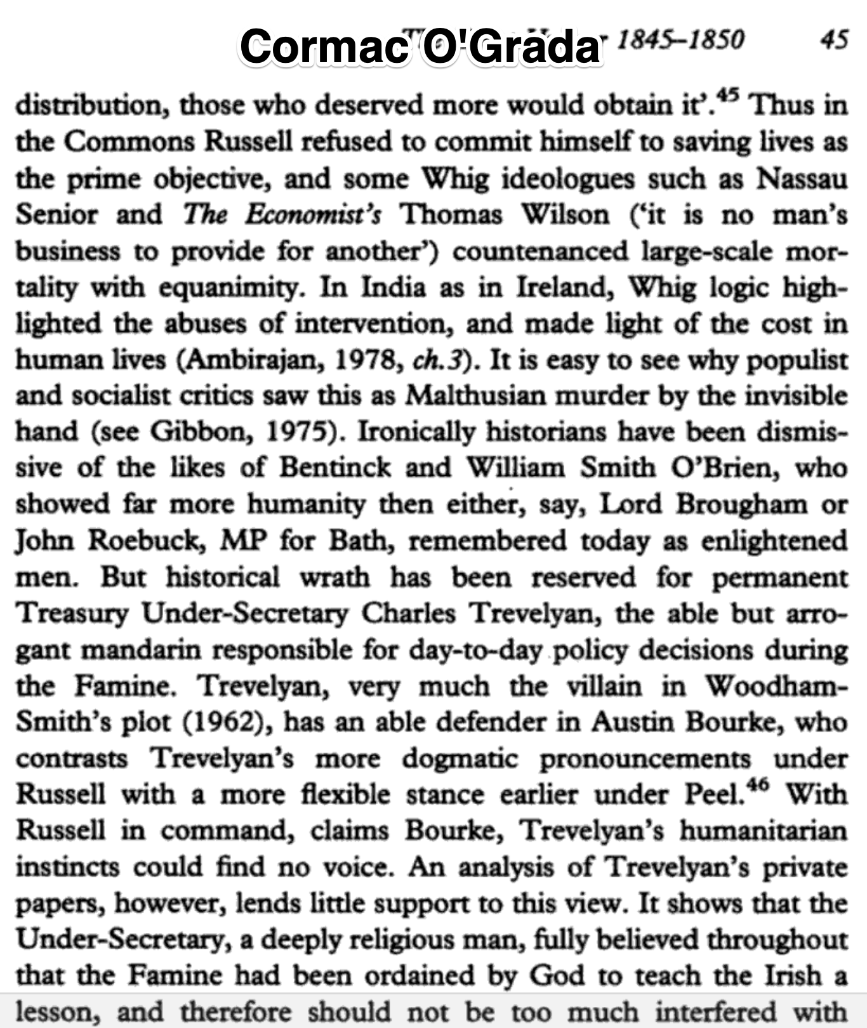
The End of Laissez-Faire
John Maynard Keynes:
“The corruption and incompetence of eighteenth-century government…. Above all, the ineptitude of public administrators strongly prejudiced the practical man in favour of laissez-faire…. Almost everything which the State did in the eighteenth century in excess of its minimum functions was, or seemed, injurious or unsuccessful.
“On the other hand, material progress between 1750 and 1850 came from individual initiative, and owed almost nothing to the directive influence of organised society as a whole. Thus practical experience reinforced a priori reasonings…”

Slide 8
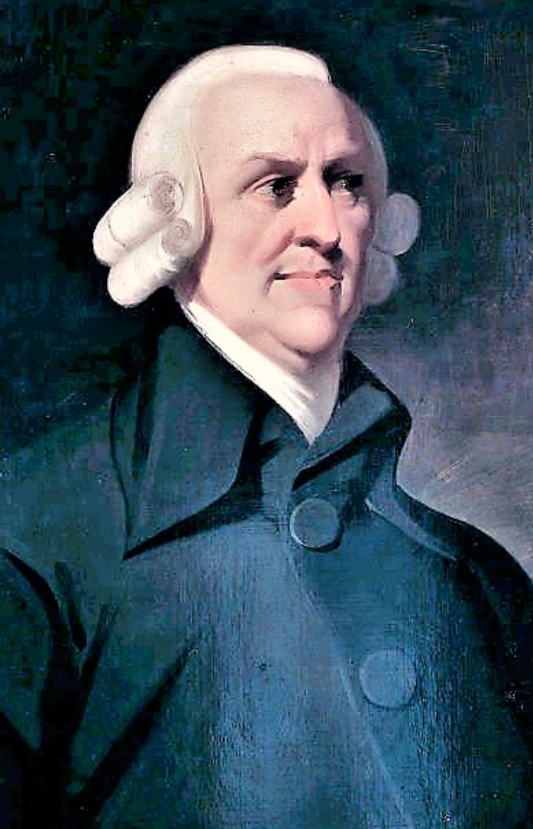
John Maynard Keynes II
The role of the economists:
“That age would have been hard put to it to achieve this harmony… if it had not been for the economists, who sprang into prominence just at the right moment….
“Suppose that by the working of natural laws individuals pursuing their own interests with enlightenment in condition of freedom always tend to promote the general interest at the same time! Our philosophical difficulties are resolved….
“To the philosophical doctrine that the government has no right to interfere, and the divine that it has no need to interfere, there is added a scientific proof that its interference is inexpedient.
“This is the third current of thought, just discoverable in Adam Smith, who was ready in the main to allow the public good to rest on ‘the natural effort of every individual to better his own condition’, but not fully and self-consciously developed until the nineteenth century begins…”

Slide 9
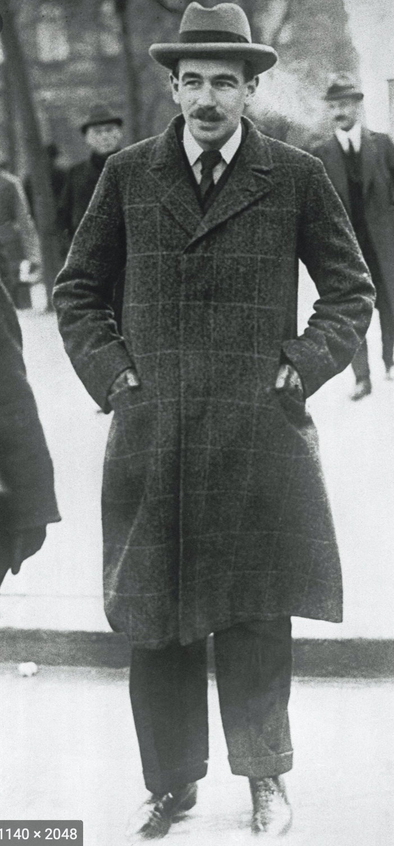
John Maynard Keynes III
“Let us clear from the ground the metaphysical or general principles:
“It is not true that individuals possess a prescriptive 'natural liberty' in their economic activities.
“There is no 'compact' conferring perpetual rights on those who Have or on those who Acquire.
“The world is not so governed from above that private and social interest always coincide.
"It is not so managed here below that in practice they coincide.
“It is not a correct deduction from the principles of economics that enlightened self-interest always operates in the public interest.
“Nor is it true that self-interest generally is enlightened….
“Experience does not show that individuals, when they make up a social unit, are always less clear-sighted than when they act separately….
“I believe that in many cases the ideal size for the unit of control and organisation lies somewhere between the individual and the modern State…”

Slide 10
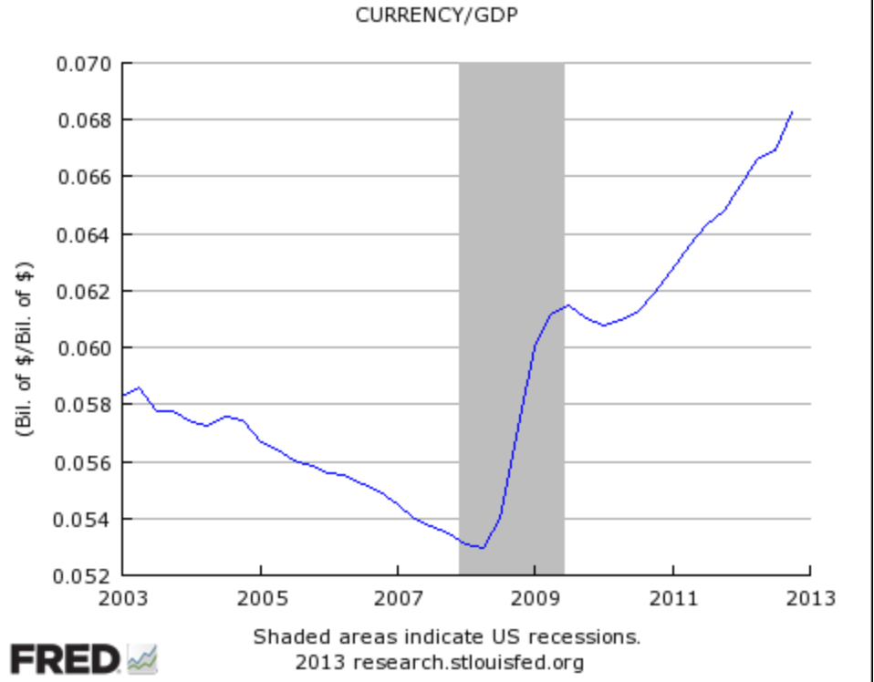
John Maynard Keynes IV
“It seems unlikely that the influence of banking policy on the rate of interest will be sufficient by itself to determine an optimum rate of investment:
“I conceive, therefore, that a somewhat comprehensive socialisation of investment will prove the only means of securing an approximation to full employment;
“though this need not exclude all manner of compromises and of devices by which public authority will co-operate with private initiative.
“But beyond this no obvious case is made out for a system of State Socialism which would embrace most of the economic life of the community…”

Slide 11
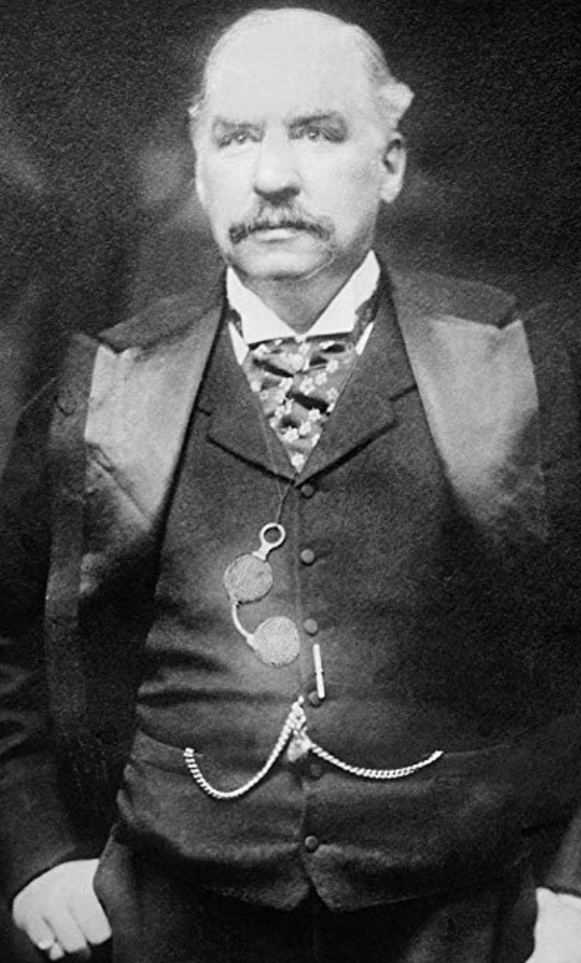
“Moderately Conservative”
John Maynard Keynes:
“Whilst, therefore, the enlargement of the functions of government, involved in the task of adjusting to one another the propensity to consume and the inducement to invest, would seem to a nineteenth-century publicist or to a contemporary American financier to be a terrific encroachment on individualism.
“I defend it, on the contrary, both as the only practicable means of avoiding the destruction of existing economic forms in their entirety and as the condition of the successful functioning of individual initiative.
“For if effective demand is deficient, not only is the public scandal of wasted resources intolerable, but the individual enterpriser who seeks to bring these resources into action is operating with the odds loaded against him…”

Slide 12
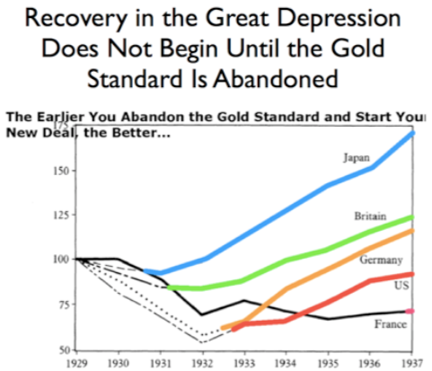
New Deals
Ending the Great Depression
The earlier a country abandons the gold standard, the better…
The earlier a government stops worrying about inflation, the better…
The earlier a government starts spending money and stops worrying about its national debt, the better…

Slide 13
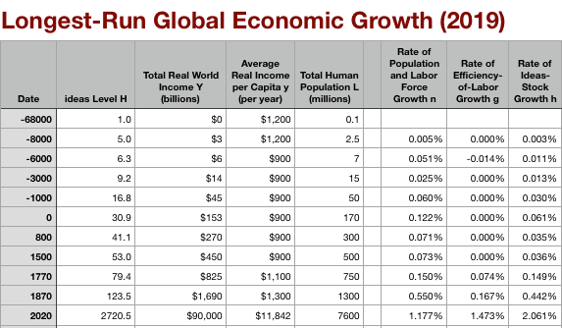
Global and “Western” Numbers
The Commercial Revolution acceleration appears everywhere
Due to globalization
And especially to the “Columbian Exchange”

Slide 14

“Western” Numbers
Is ‘the west’ special between 800 and 1500?
Or is it just recovery from a Dark Age depression?

Slide 15
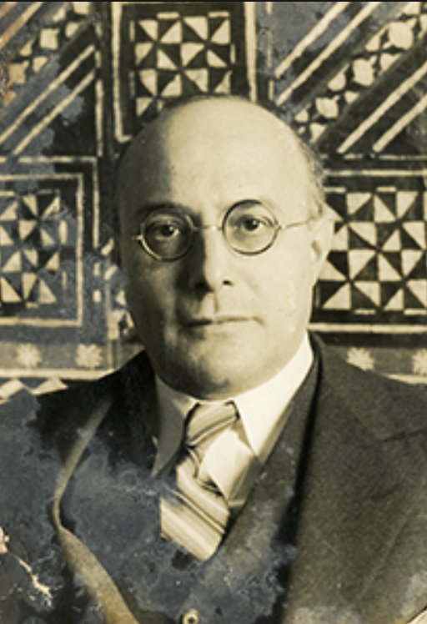
“Fictitious Commodities”
Karl Polanyi:
“In regard to labor, land, and money… to allow the market mechanism to be sole director of these and their natural environment… would result in the demoli­tion of society. For the alleged commodity “labor power” cannot be shoved about, used indiscriminately, or even left unused, without affecting also the human individual who happens to be the bearer of this peculiar commodity. In disposing of a man’s labor power the system… would… dispose of the… ‘man’ attached to that tag. Robbed of the protective covering of cultural institutions, human beings would perish from the effects ofsocial exposure; they would die as the victims of acute social dislocation through vice, perversion, crime, and starvation….
“Nature would be reduced to its elements, neighborhoods and landscapes de­filed, rivers polluted, military safety jeopardized, the power to pro­duce food and raw materials destroyed.
“Finally, the market adminis­tration of purchasing power would periodically liquidate business enterprise, for shortages and surfeits of money would prove as disas­trous to business as floods and droughts in primitive society…”

Slide 16
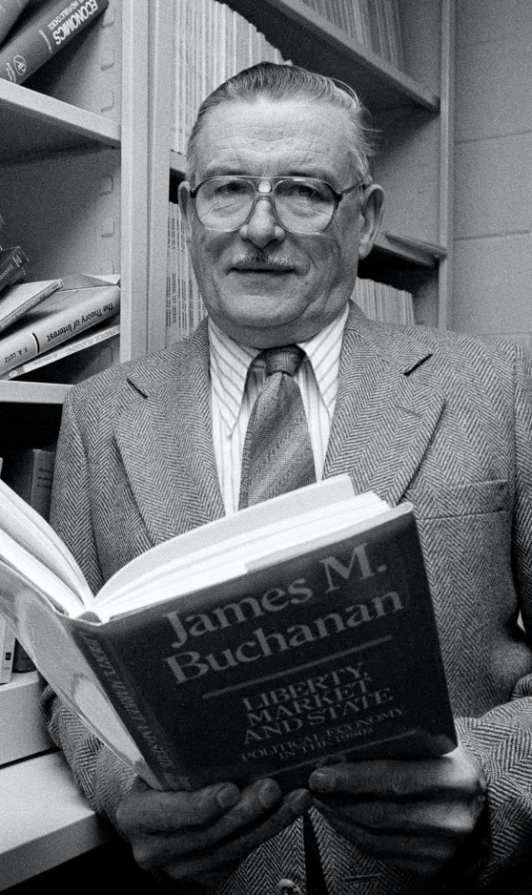
Counteroffensive from Mt. Pelerin
James Buchanan:
“The Keynesian episode in economics is… orthogonal to any attribution of progression or retrogression in the hard core of the research program of the discipline.
“The Keynesian enterprise can be interpreted as an ultimately failed attempt to jury-rig improvements on a structure of institutional constraints that were nonsustainable….
“he whole exercise [w]as an aberration that was grounded in rather elementary misunderstanding of what the classical vision of political economy embodies….
“It seems naive to think that ‘the market’… can operate effectively… adjust quickly to a dramatic reduction in the politically-influenced and unpredictable supply of money?
“It must remain forever mysterious as to why Keynes and the Keynesians were willing to neglect prospects for institutional reforms in the effective monetary constitution, while, at the same time, proposing radical changes along other more specific dimensions of policy....
“The Keynesian tragedy is locatcd in the timidity of its nostrums in the face of existing institutions, accompanied by its willingness to replace market evaluations by politicized controls over particular choice vectors (employment, investment)…”

Slide 17
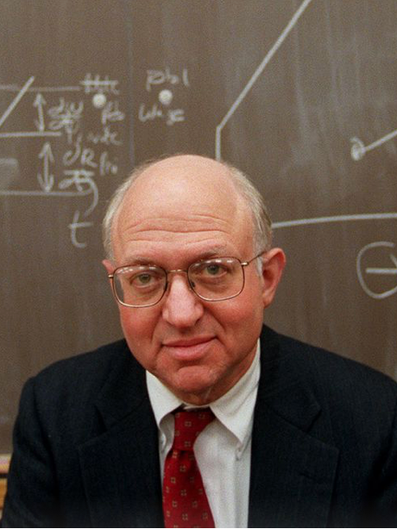
The U.S. 1970s
Martin Feldstein:
“The growth of productivity per man-hour in the private business sector dropped from an annual rate of 3.2 percent during 1947-67 to less than 1.5 percent since 1967 and less than 1 percent since 1973.
“The average unemployment rate rose from 4.7 percent of the labor force to 5.8 percent.
“The average rate of consumer price index (CPI) inflation jumped from 2 percent to 6.7 percent (since 1967) with an acceleration to an average of nearly 9 percent since 1973 and over 13 percent in 1979.
“The Standard and Poor's index of common stock prices… between 1949 and 1969… after adjusting for the rise in the general consumer price level… increased by more than 300 percent.
“In the decade since 1969, however, the index… in constant dollars fell nearly 50 percent….
“Many of the papers and comments in this volume point to the expanded role of government as a major reason, perhaps the major reason, for the deterioration of our economic performance.
“The government's mismanagement of monetary and fiscal policy….
“Government regulations are a principal cause of lower productivity growth and of the decline in research and development.
“The growth of government income-transfer programs has exacerbated the instability of family life and perhaps the decline in the birthrate.
“The low rate of saving and the slow growth of the capital stock reflect tax rules, macroeconomic policies, and the growth of social insurance programs….
“There can be no doubt that government policies do deserve substantial blame for the adverse experience of the past decade…”

Slide 18
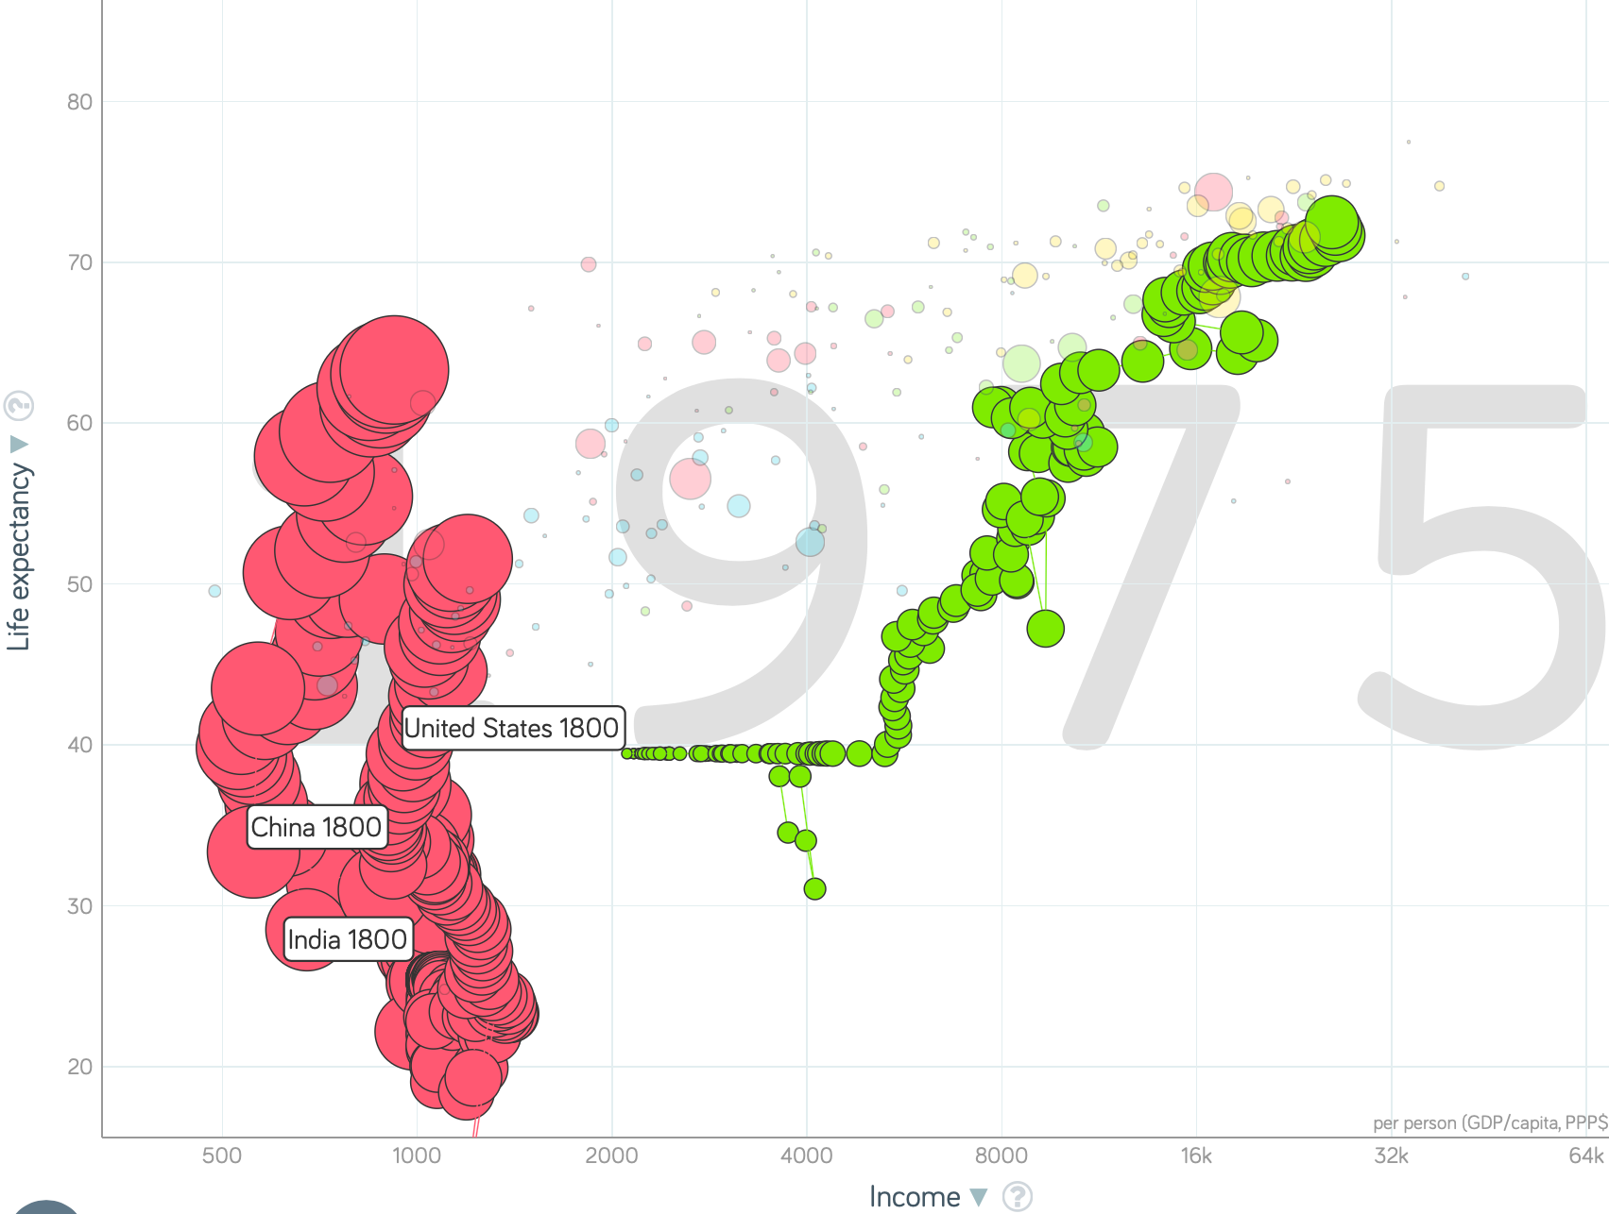
China and India and America, 1800-1975
From 1800 to 1975:
Measured living standards and productivity levels improve fourteen-fold in the United States…
…& less than 30% in China & India…
…in spite of economic, transport, and cultural globalization…
This is crazy!
A “great divergence”
Not only were China & India relatively poor in 1800, they fell further behind thereafter

Slide 19
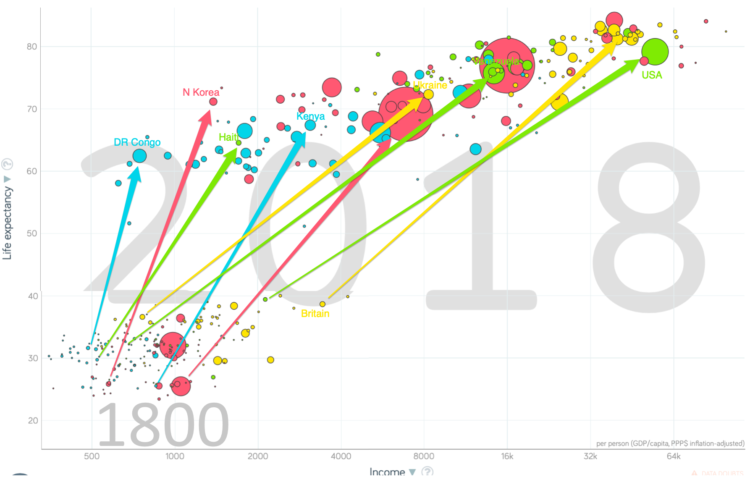
One Figure: A Great Divergence
From 1800 to 2018:
The dots start with a 3-1 spread in incomes and a 10-year spread in life expectancy.
All the arrows go up.
Some arrows—mostly those already to the right—go right fast.
Other arrows go right slowly.

Slide 20

Democratic Presidents
Bill Clinton:
“Big Government does not have all the answers….
“There’s not a program for every problem.
“We know, and we have worked to give the American people a smaller, less bureaucratic Government in Washington.
“And we have to give the American people one that lives within its means.
“The era of big Government is over.
“But we cannot go back to the time when our citizens were left to fend for themselves…. Our new, smaller Government must work in an old-fashioned American way, together with all of our citizens through State and local governments, in the workplace, in religious, charitable, and civic associations…”

Slide 21

China and India and America, 1975–2018
From 1975-2018:
Measured living standards and productivity levels…
…54.9/25.9 = 2.12 in America…
…16.0/0.9 = 17.8 in China… 6.6%/year
…6.9/1.2 = 5.8 in India… 4.2%/year

Slide 22

Barack Obama
January 2010: unemployment rate above 9%:
“Families across the country are tightening their belts and making tough decisions.
“The federal government should do the same. (Applause.)
“So tonight, I'm proposing specific steps to pay for the trillion dollars that it took to rescue the economy last year.
Starting in 2011, we are prepared to freeze government spending for three years….
“Like any cash-strapped family, we will work within a budget to invest in what we need and sacrifice what we don't.
“And if I have to enforce this discipline by veto, I will. (Applause.)
We will continue to go through the budget, line by line, page by page, to eliminate programs that we can’t afford and don't work. We’ve already identified $20 billion in savings for next year.…”

Slide 23
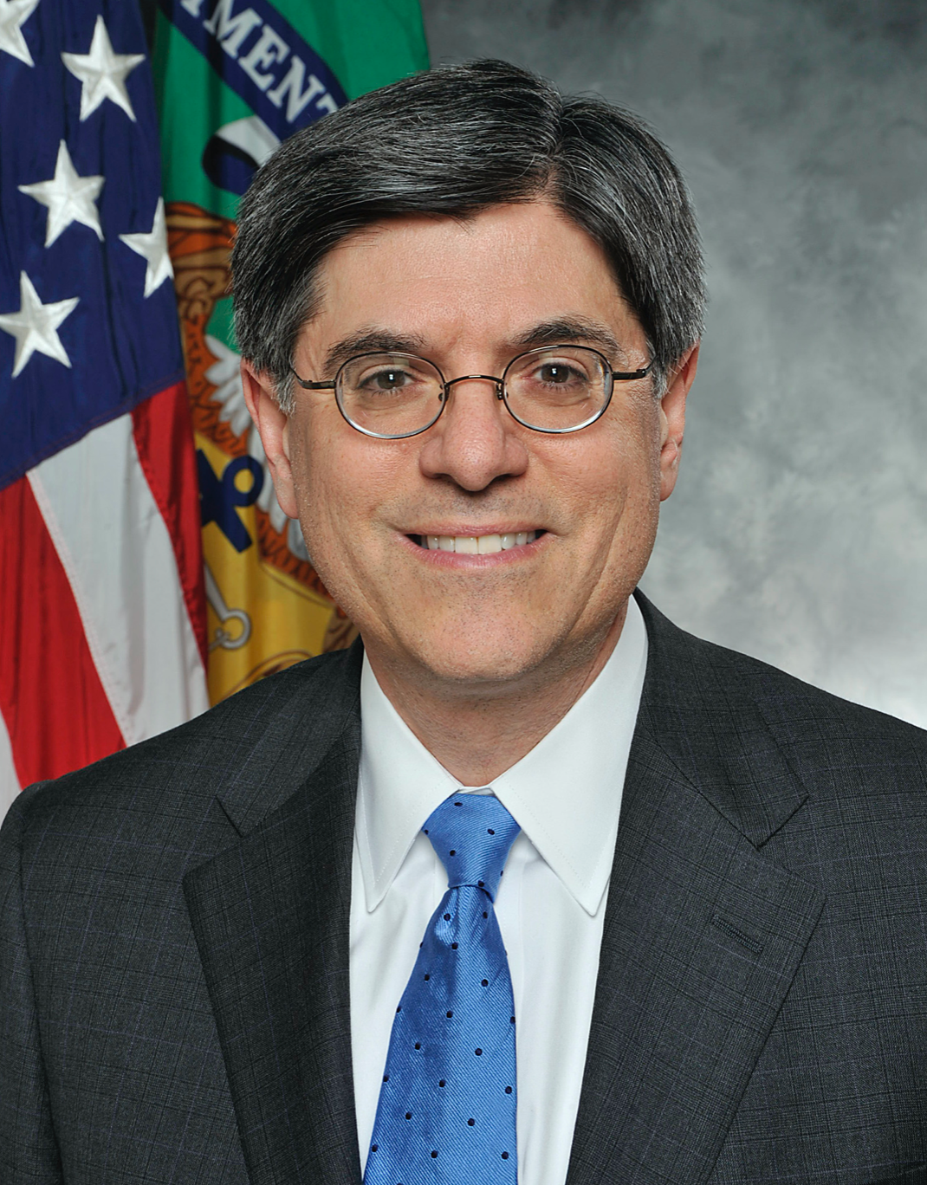
Treasury Secretary Jack Lew
November 2010:
“To lay the foundation for long-term economic growth and to make our nation competitive for years to come, we must put the United States back on a sustainable fiscal course. And that’s going to require some tough choices.
“Today, the President made one of those: proposing a two-year pay freeze for all civilian federal workers. This will save 2 billion over the remainder of this fiscal year, 28 billion in cumulative savings over the next five years, and more than 60 billion over the next 10 years….
“Make no mistake: this decision was not made lightly. Like everyone honored to serve in the White House or the Cabinet, we work with extraordinarily talented public servants every day….
“This pay freeze is not a reflection on their fine work. It is a reflection of the fiscal reality that we face: just as families and businesses across the nation have tightened their belts, so must the federal government…”

Slide 24
Further Reading
John Maynard Keynes (1926): The End of Laissez-Faire <https://delong.typepad.com/files/keynes-end-of-lf.pdf>
John Maynard Keynes (1936): Concluding Notes on the Social Philosophy Towards Which the General Theory Might Lead <https://delong.typepad.com/files/keynes-social-philosophy.pdf>

Slide 25
Catch Our Breath…
Ask a couple of questions?
Make a couple of comments?
Any more readings to recommend?

Slide 26
Notes

